Slide 1
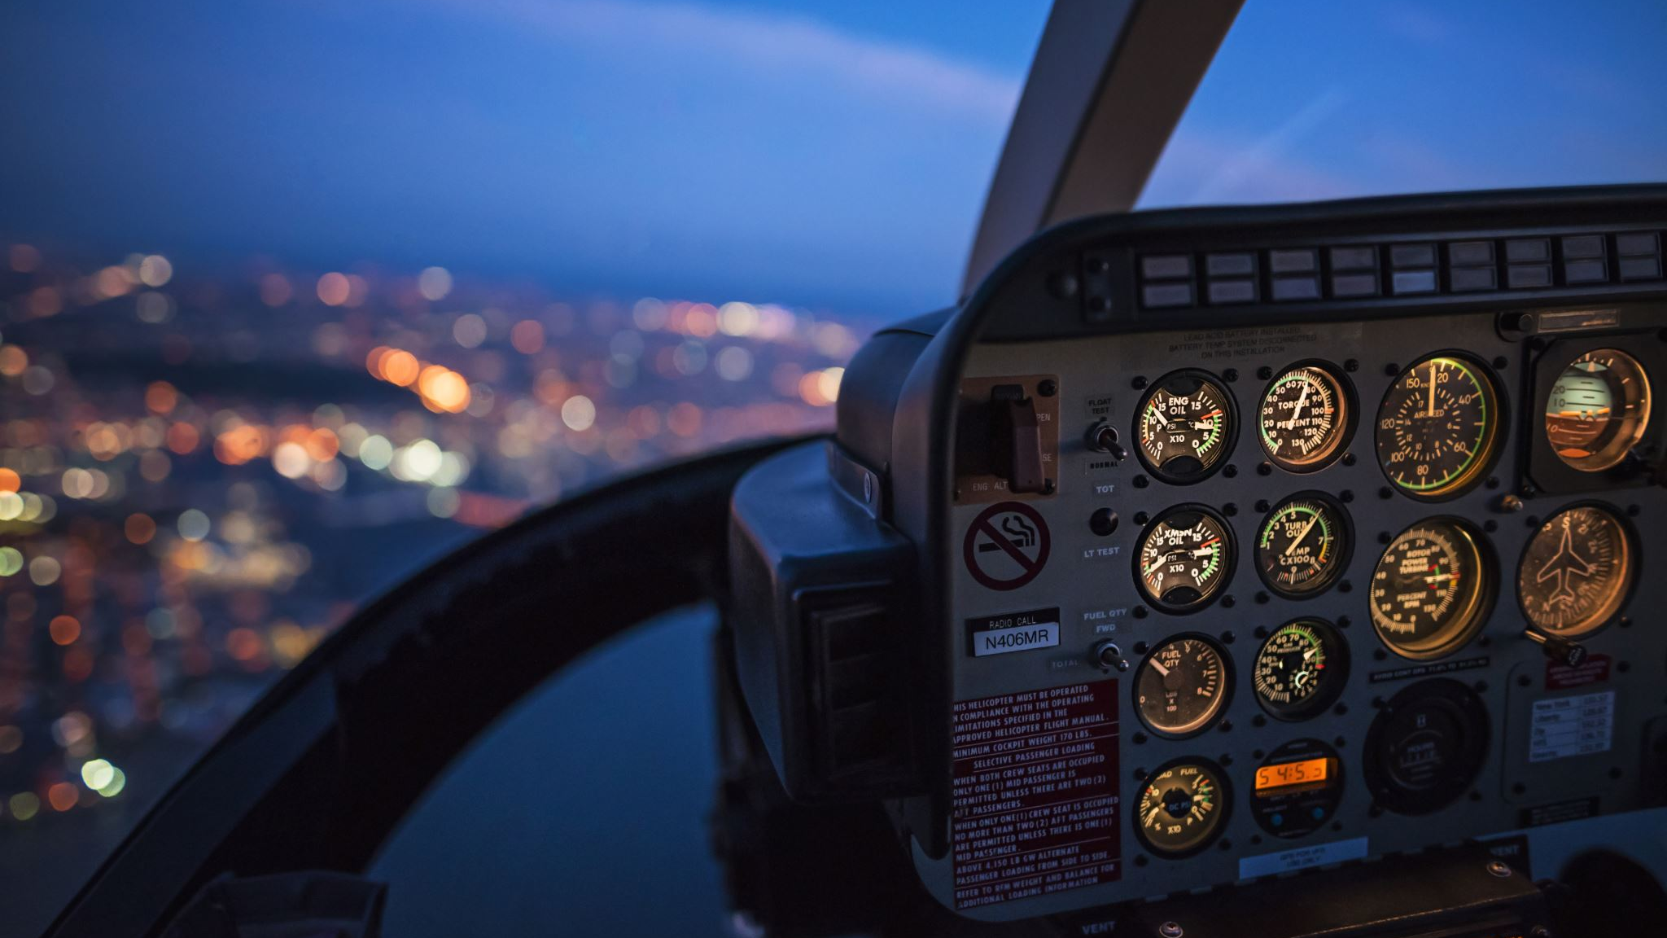
Arti Mahaldar – Project Milestone1
Airline Safety Dashboard

Slide 2
